Slide 1
Michigan Arts Education Instruction and Assessment
Writing a SLO for Demonstrating
Educator Effectiveness

Slide 2
Introductions
Pilot Participants
Carrie Jeruzal – K-12 Art Teacher, Pentwater PS
Cecilia Gollan – HS Art Teacher, Huron Valley Schools
MAC Staff
Ed Roeber
Jason O’Donnell
Pilot Project Web Page http://michiganassessmentconsortium.org/maeia-demonstrating-educator-effectiveness-pilot-project
Website with all MAEIA resources & tools
http://www.maeia-artsednetwork.org
Notes:
We have approximately 30 pilot participants – a combination of arts teachers and supervising administrators – from districts across the state and representing theatre, dance, visual, arts and music K-12. A roster of participants is available on the web page noted on the screen.
The MI Assessment Consortium is a non-profit, non-partisan education organization focused on promotion of quality assessment systems and practices – we have been commissioned by the MDE to make the resources and tools available through this program.
For the pilot project you are served by – Kathy Dewsbury-White, MAC CEO and MAEIA Project Director, Ed Roeber MAC and MAEIA project Assessment Director, Linda Wacyk, Communications Director and Jason O’Donnell executive assistant and project support.

Slide 3
Overview of the Webinar
Project participants requested information on the following topics
SLO development resources from MDE and others
Overview of the SLO template available from MDE
Practical suggestions for creating useful and useable SLOs in the arts
Each of these will be addressed in the webinar

Slide 4
MDE SLO Resources
MDE Resources for Writing a SLO

Slide 5
MDE SLO Resource Page
Google “MDE”
Select Michigan Department of Education from the list
Search on “SLO”
This page loads:
http://www.michigan.gov/mde/0,4615,7-140-5683_75438-375532--,00.html

Slide 6
MDE SLO Resource Page

Slide 7
Student Learning Objectives Guidance Document

Slide 8
Student Learning Objectives FAQ

Slide 9
Student Learning Objectives Checklist

Slide 10
MDE SLO Template
Step-by-Step Overview of the MDE SLO Template

Slide 11
Student Learning Objectives Template

Slide 12
Student Learning Objectives Template

Slide 13
Student Learning Objectives Template

Slide 14
Student Learning Objectives Template

Slide 15
Student Learning Objectives Template

Slide 16
Other SLO Resources
Traverse Bay ISD Resources on SLOs

Slide 17
TBAISD SLO Modules

Slide 18
TBAISD SLO Module 4

Slide 19
TBAISD Module 4 – Guiding Questions

Slide 20
TBAISD Module 4 – Developing a SLO

Slide 21
TBAISD SLO Modules
https://drive.google.com/drive/folders/0BxrLTrmGfGG1eTBrVzV6UzZQQkE?usp=sharing

Slide 22
Q & A on SLO Development
Creating a Useful and Useable SLO in the Arts

Slide 23
Question 1
What was your overall approach to the creation of the SLO you developed?
Step-by-step
Tackle some parts of the template first
Other

Slide 24
Questions 2 & 3
What parts of the SLO development process were relatively easy to complete?
Which parts were more challenging?

Slide 25
Question 4
What data sources did you use to describe the student population for your SLO?
What baseline data on your students did you have available? What were the sources of the data?
Did your district or school databases contribute to this is in any way?

Slide 26
Question 5
Which assessments did you choose in your SLO?
Did you use one or multiple assessments? Why?
Did you use any of the MAEIA assessment(s)? If so, did you use them as is, or did you adapt them?
Did you create or adapt any other assessments?

Slide 27
Question 6
How did you establish student growth targets?
How did you assure that the targets were appropriate and reasonable for your students?
Did you use any data to identify student needs?
Were your targets related to your school and district goals? If so, how?

Slide 28
Question 7
How did you describe the instruction you planned?
Did this change at all when you actually implemented the instruction?
Did you formally or informally document what you actually taught? What did this documentation look like?
If so, was this useful in your use of the SLO to demonstrate your effectiveness?

Slide 29
Question 8
Briefly describe the manner in which the SLO was used in your overall teacher evaluation
How much of your overall evaluation was the SLO?
How useful was the SLO for this?
Did the individual who evaluated you understand the SLO you created and used? Did he or she find the SLO useful?

Slide 30
In Closing
I hope that this webinar has been helpful to you as you think about developing a SLO in the arts
Thanks to Carrie and Cecilia for their thoughtful ideas and input about their experiences in developing and using a SLO
A couple of reminders for each of you

Slide 31
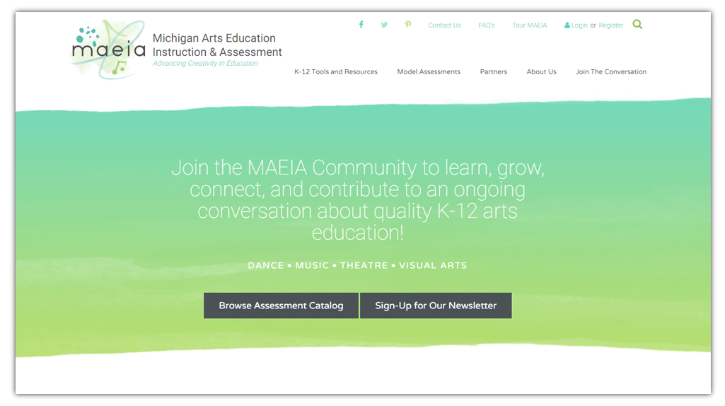
maeia-artsednetwork.org

Slide 32
Upcoming DEE Webinars
MAEIA DEE Webinar 3 – Documenting Instruction
Wed, Mar 22, 2017
3:00 PM - 4:30 PM EST
Please join my meeting from your computer, tablet or smart phone https://global.gotomeeting.com/join/310299149 You can also dial in using your phone. United States: +1 (872) 240-3311 Access Code: 310-299-149
MAEIA DEE Webinar 4 – Putting the DEE All Together (April 19)
In-Person Project Meeting (May 24)

Slide 33
Contact Us
MAEIA Project
517-816-4520
maeia.artsed@gmail.com
Ed Roeber
roeber@msu.edu
Jason O’Donnell
jodonnell@michiganassessmentconsortium.org
Pilot Project Web Page http://michiganassessmentconsortium.org/maeia-demonstrating-educator-effectiveness-pilot-project

